Slide 1
Advanced Topics - 2
(Ack: Ishrat Jahan)

Slide 2
Load Balancing

Slide 3
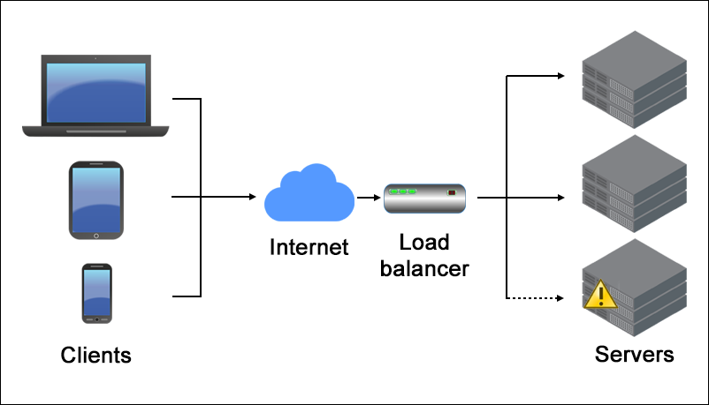
Load Balancing

Slide 4
High Availability

Slide 5
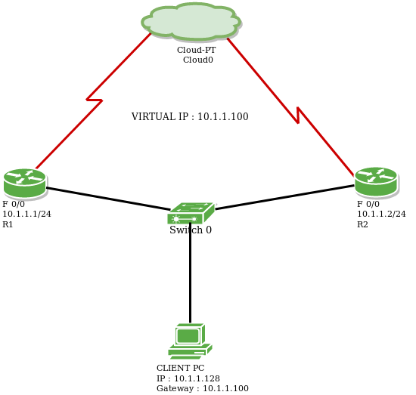
VRRP - Virtual Router Redundancy Protocol

Slide 6
SDN (Software Defined Networking)

Slide 7
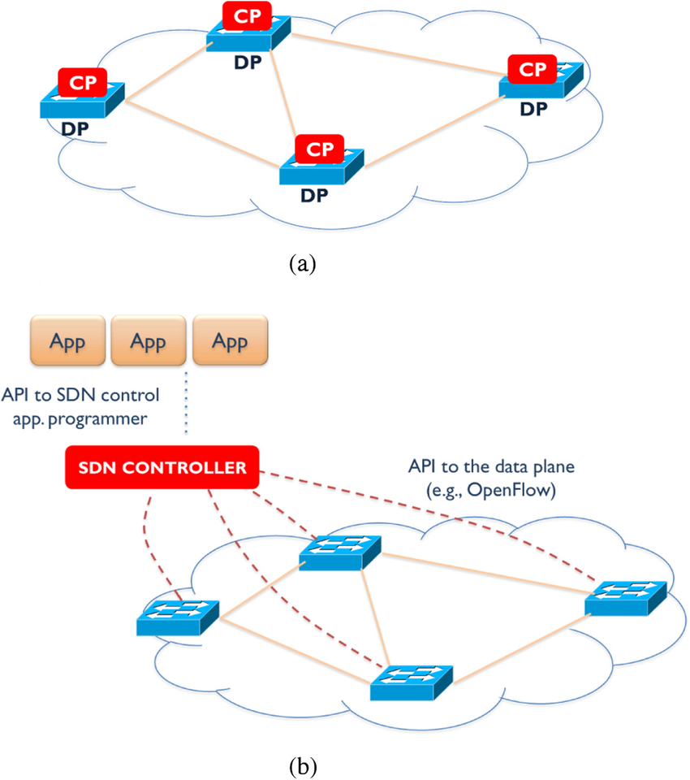
CP - Control Plane DP - Data Plane
Traditional networking
SDN

Slide 8
Network Virtualization

Slide 9
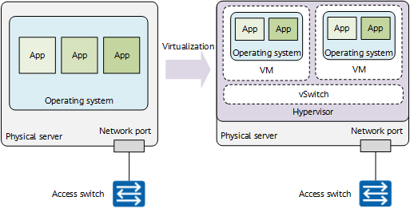
Server Virtualization

Slide 10
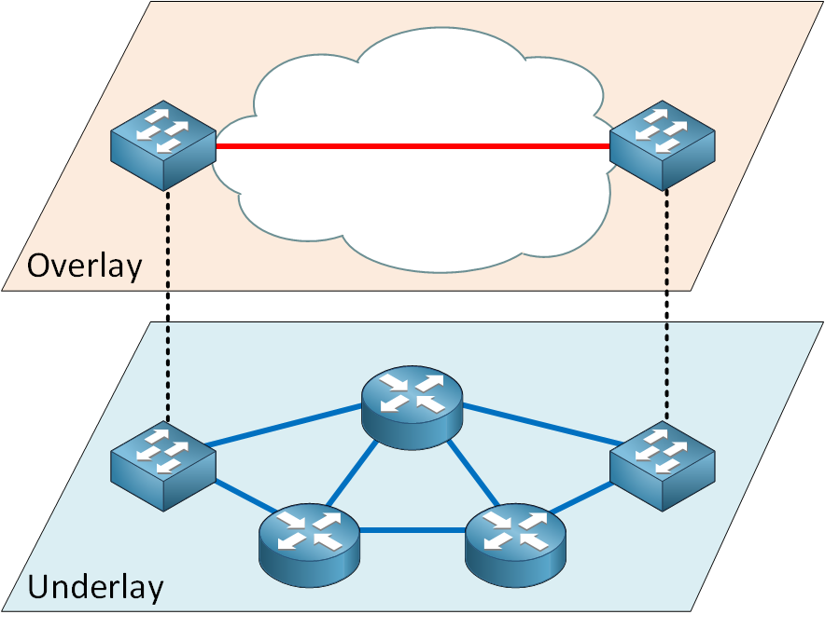
Network Virtualization (Overlay vs Underlay)

Slide 11
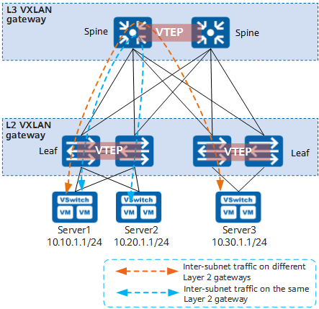
VXLAN
For details, please check this website.

Slide 12
Data Centers and Disaster Recovery

Slide 13
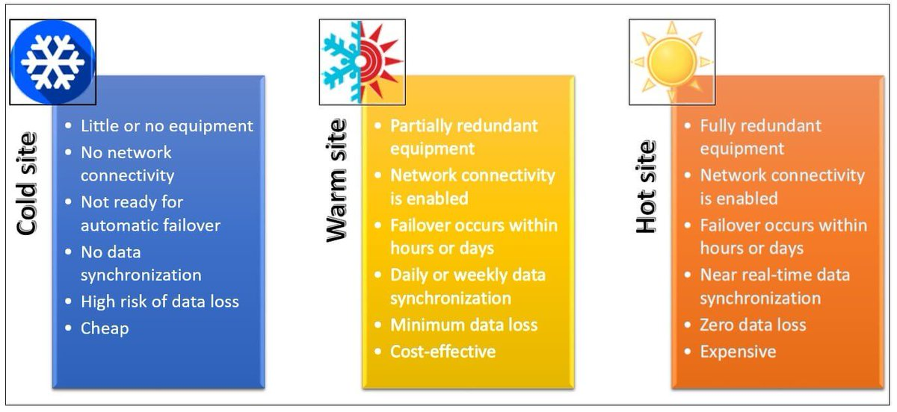
DC-DR

Slide 14
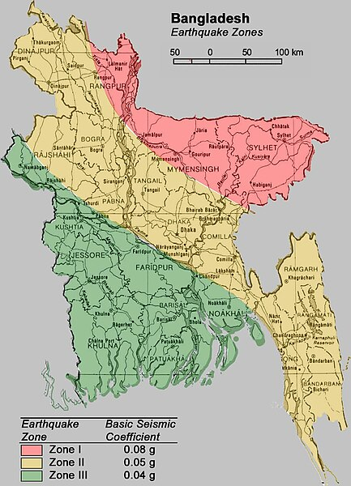
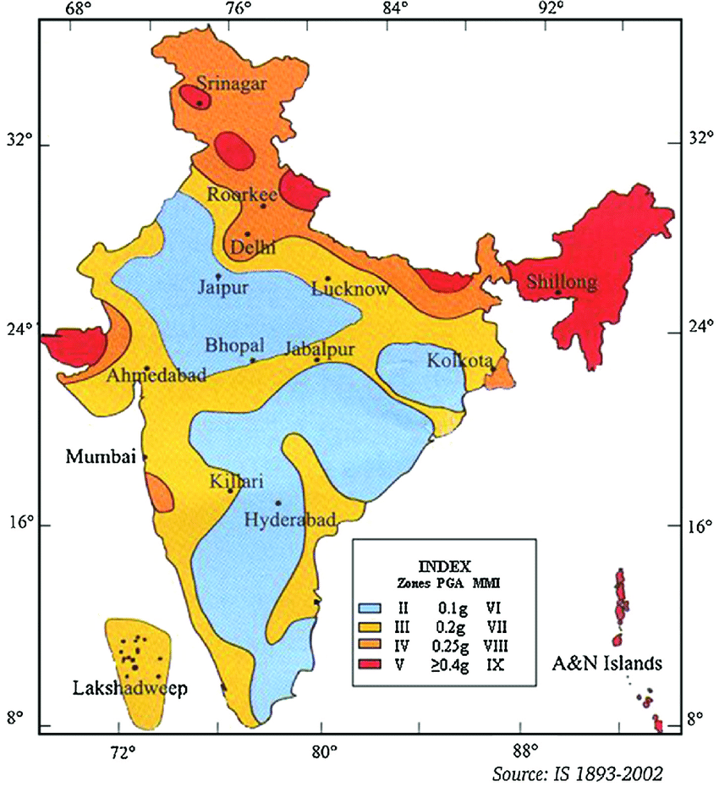
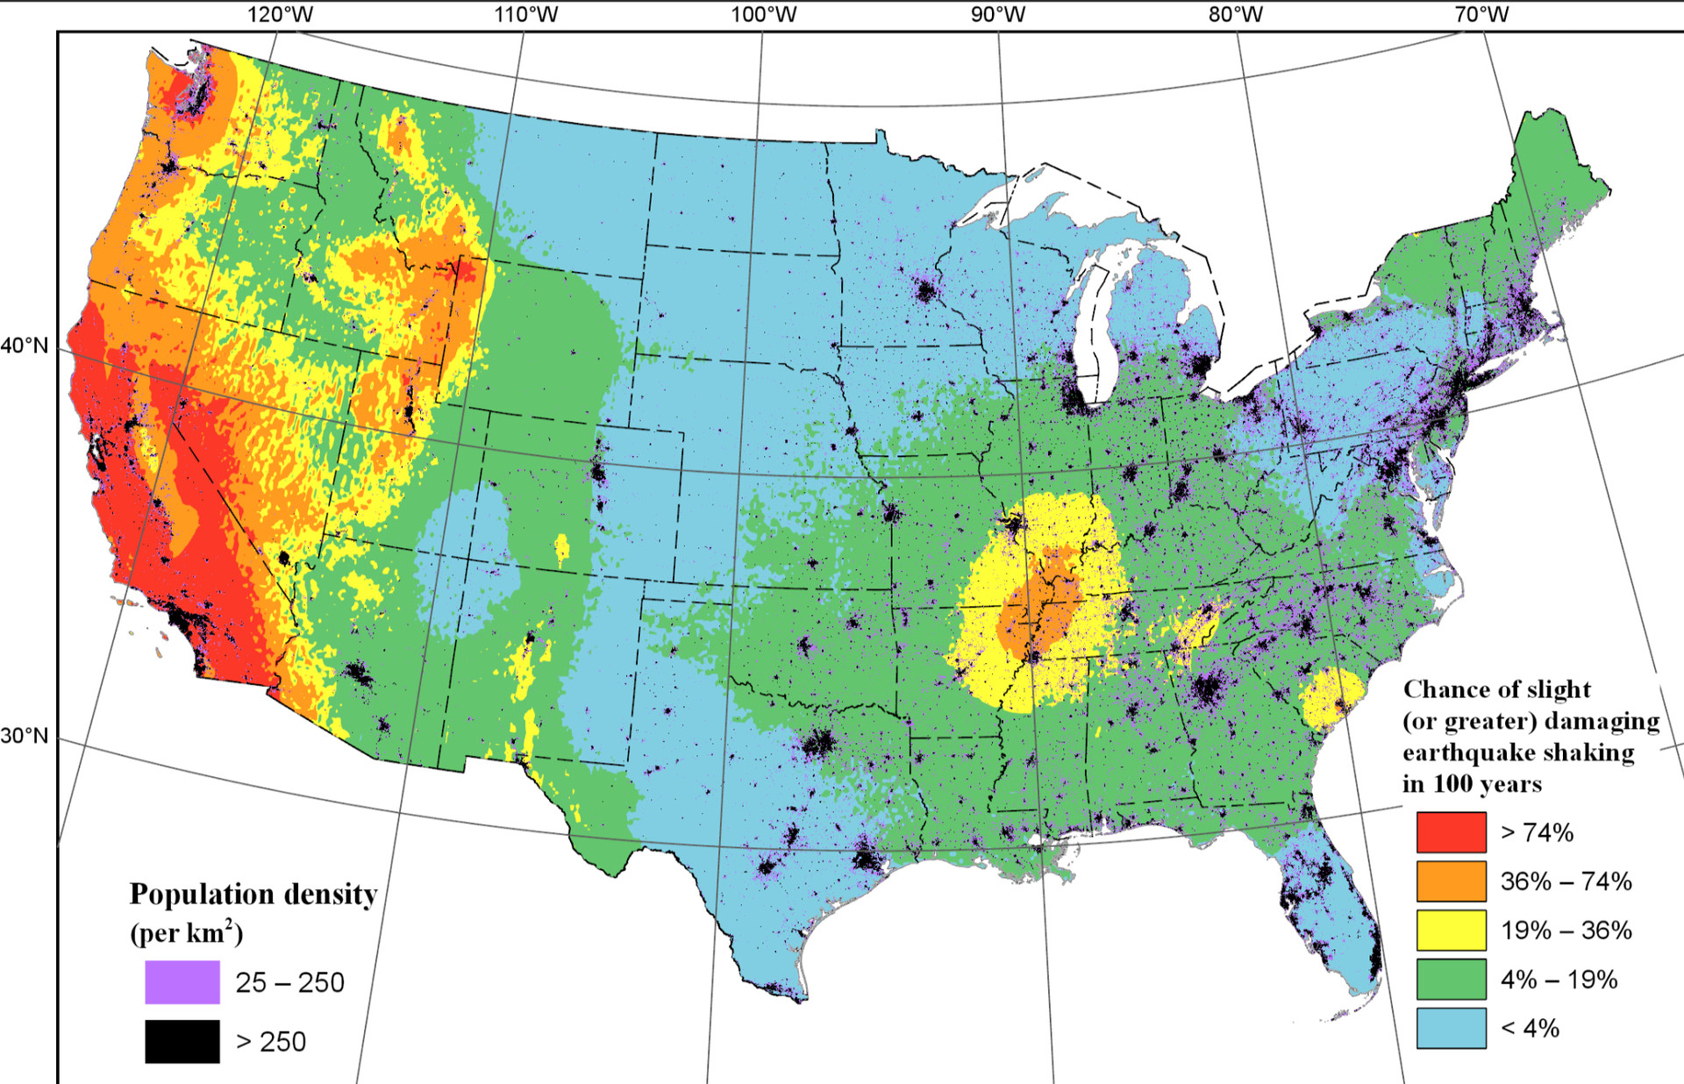
Earthquake Zones – An Important Consideration for DR

Slide 15
Thank You!

